Slide 1
Assessing the Performance of Dialysis Facilities Participating in the End Stage Renal Disease (ESRD) Network Program
INFO 550 Final Project
Shaily Krishan, MPH
May 3rd, 2018

Slide 2
Introduction
Chronic Kidney Disease (CKD)
About 30 million US adults are estimated to have CKD
Kidney diseases are the ninth leading cause of death in the US
96% of people with kidney damage or reduced kidney function are unaware of having CKD
More than 300 people begin dialysis treatment for kidney failure every 24 hours
75% of new cases of kidney failure in the US are caused by diabetes and high blood pressure
In 2015, total Medicare costs for CKD and ESRD treatment in the US were $98 billion

Slide 3
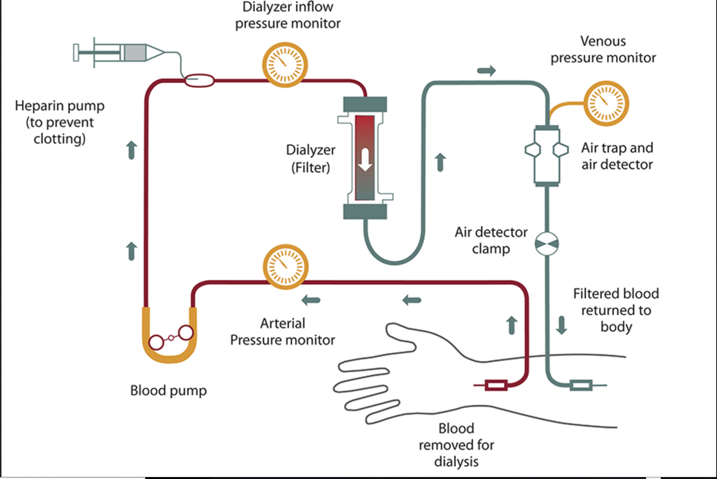
End Stage Renal Disease (ESRD) & Dialysis
Dialysis is a process of filtering the blood, and is needed for patients with “End Stage Renal Disease”
Dialysis helps control blood pressure and maintain mineral balance in blood
There are two types of dialysis: Hemodialysis and Peritoneal dialysis
The process involves access to the patient’s bloodstream using a ‘vascular access’ site, usually a fistula, graft, or a catheter
Patients undergoing hemodialysis are at high risk of infections such as Staphylococcus aureus and other bloodstream infections and viral hepatitis.
https://www.niddk.nih.gov/health-information/kidney-disease/kidney-failure/hemodialysis
https://www.cdc.gov/dialysis/patient/index.html

Slide 4
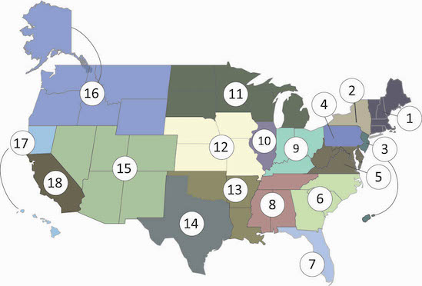
End Stage Renal Disease Networks
An ESRD Network is defined as all Medicare-approved ESRD facilities in a designated geographic area specified by CMS
Coordination between networks enables efficient patient referral and access to resources
CMS monitors and evaluates quality improvement programs, some quality improvement initiatives include reducing the rate of blood stream infections, reducing patient hospitalization, and increasing the number of kidney transplants
There are 18 ESRD networks in the US
www.esrdnetworks.org

Slide 5
Data Sources
Dialysis Facility Compare (DFC) data is available at https://data.medicare.gov/data/dialysis-facility-compare
DFC datasets listed below were accessed using SOCRATA API available on the Medicare website. API access requires creating an account and obtaining apptokens, and using Rsocrata package
Dialysis Facility Compare - Listing by Facility
ESRD QIP - Complete QIP Data - Payment Year 2018
Patient survey (ICH CAHPS)
R Code used:
## install.packages("RSocrata")
library("RSocrata")
df <- read.socrata( "https://data.medicare.gov/resource/eqxu-aw4f.json",
app_token = "YOURAPPTOKENHERE",
email = "user@example.com",
password = "fakepassword")

Slide 6
Data Sources
Dialysis Facility Report data is available at: https://www.dialysisdata.org/content/dialysis-facility-report-data
This dataset was primarily used to extract variables related to Race, Ethnicity, ESRD cause, number of kidney transplants
Read in using Readr package
US Chronic Disease Indicators: Chronic Kidney Disease Prevalence data is available at: https://catalog.data.gov/dataset?tags=chronic-kidney-disease
This dataset was used to extract the 2016 crude prevalence rates of Chronic Kidney Disease from BRFSS data
Data was imported into DB Browser for SQLite, and read in using RSQLite package:
ckd_prev <- dbGetQuery(con,"select LocationAbbr,avg(DataValue) from CKD_prev
where DataValueTypeID='CrdPrev' and
Question like '%kidney%' and
YearStart='2016' group by LocationAbbr")
Zip Code XY coordinates obtained from R “zipcode” package
Twitter
Patient forum data accessed from: https://patient.info/forums/discuss/browse/kidney-failure-and-ckd-1300

Slide 7
Lessons learned with data source import techniques
Variable names in data files are not ‘R- friendly’
Most numeric variables are in character format, so there is a significant amount of cleaning and prep work involved
Although I uncovered the Socrata API later in the semester, I realized that it was a much ‘cleaner’ method to import data, and that APIs are probably better options than importing raw data files
The API import significantly reduced variable name cleaning efforts

Slide 8
Original research questions
What is the geographical distribution of state average performance scores (map), and is there relationship with demographic characteristics and prevalence of CKD in lower performing states?
What are some factors affecting morbidity and mortality rates in dialysis facilities? Is there a relationship between mortality, number of dialysis stations in facilities, and network hospitalization?
What is the relationship between facility blood stream infection scores and total performance score with network payment reduction percentage?
What are some factors related to the differences in the number of transplants in networks? What are the patient characteristics associated with transplants? Is there a temporal pattern?
What are people in the US discussing about Dialysis on Twitter? Are people from certain geographic areas more active on Twitter, and is there a geographic relationship with observed state performance measures, and CKD prevalence?

Slide 9
Progression
My original intent of exploring the data did not change, so I made numerous descriptive plots and aggregations to explore the variables of interest
Mortality was originally the key variable of interest, because I assumed that I would be able to explore a number of relationships
However, it became apparent in later analyses that even though there is some variability in mortality across facilities, it is not very strongly correlated with patient characteristics or clinical quality measures
I extended my original research questions to identifying clusters in the data, and identifying predictors of total performance score

Slide 10
Research questions
What is the distribution of patient mortality and morbidity within performance score categories and five star rating categories?
What are the predictors of total performance scores in dialysis facilities?
Are there any specific cluster patterns in these data? An assumption would be that observed clusters would align with observed categories of total performance scores/ five star rating
What are some factors associated with the differences in the number of transplants in networks?
What is the sentiment of public discussion about Dialysis on social media sites, news articles, and patient forums?

Slide 11
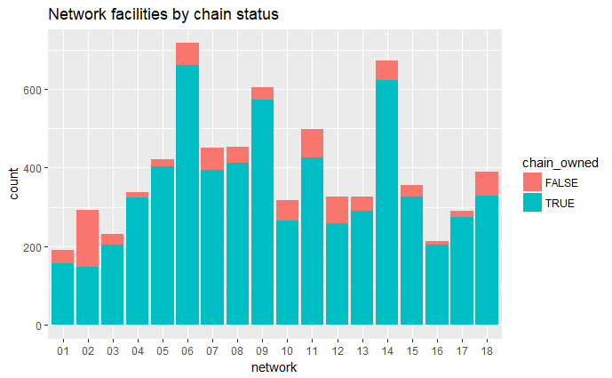
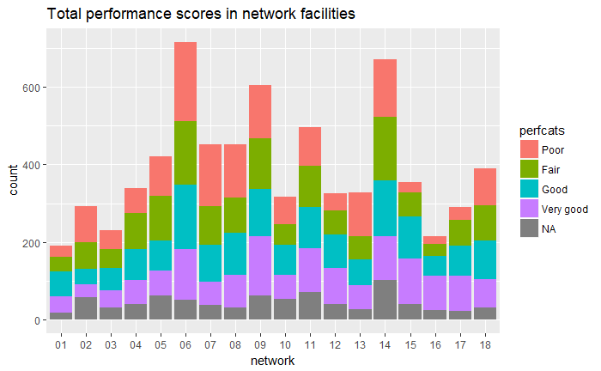
ESRD Networks Facilities & “Chain-status”
Of the 7084 facilities, 6273 (88%) are chain owned
Most networks have a mix of poor- very good performinf facilities
Notes:
A majority of facilities are chain owned: Chain owned=6273, not chain owned=811, 89% are chain owned facilities

Slide 12
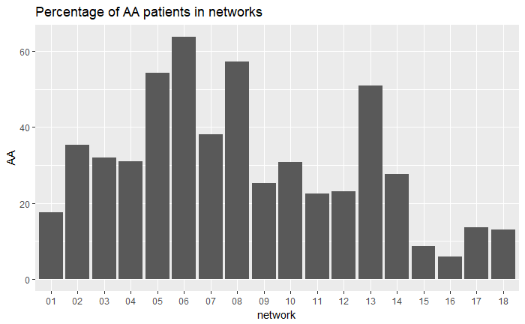
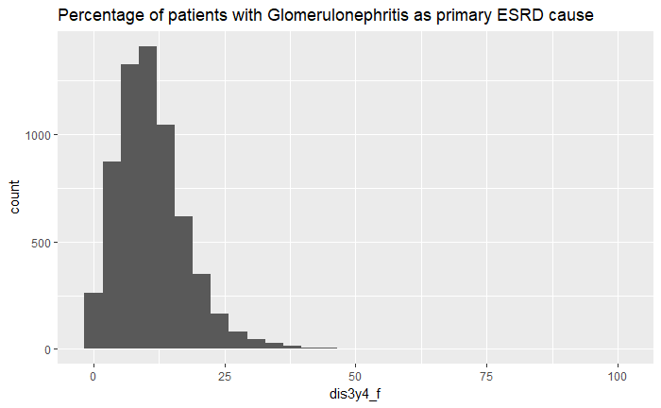
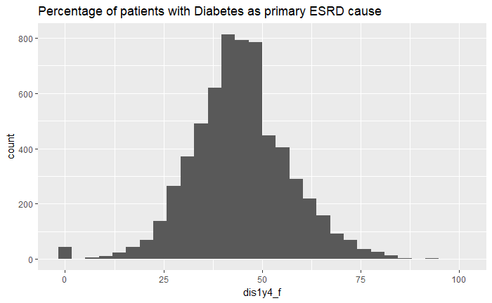
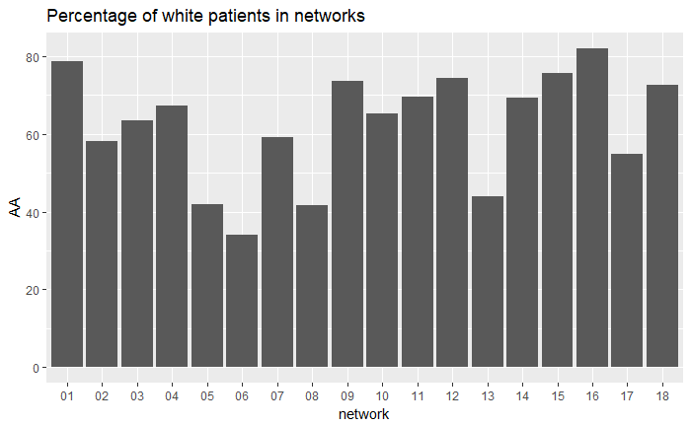
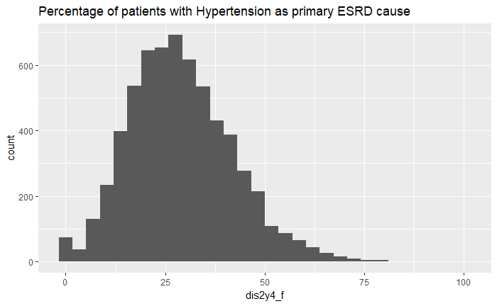
Patient characteristics
Mean percentage of AA patients in networks is 60%, mean percentage if White patients is 33%
An average of 44% patients report Diabetes as the primary cause of ESRD, and about 29% report hypertension as the primary cause of ESRD

Slide 13
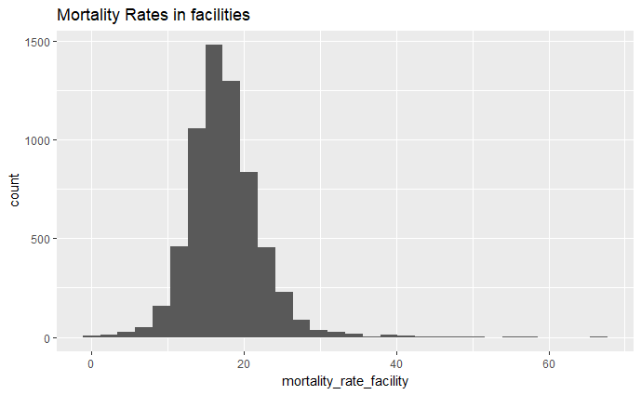
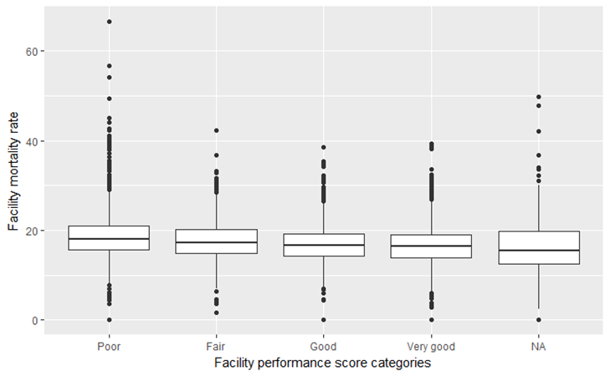
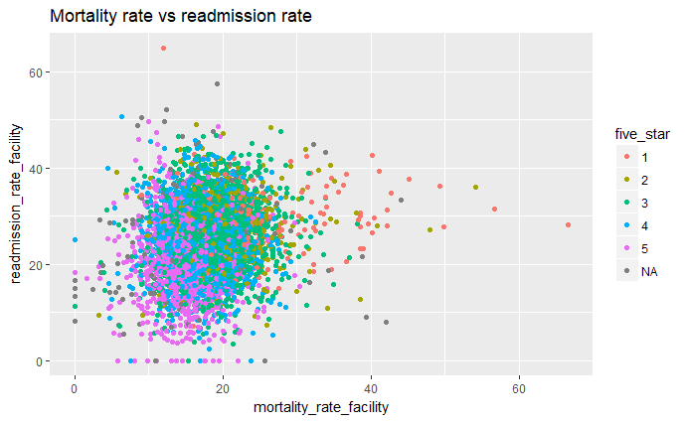
Mortality Rate
The mean mortality rate is 17% in dialysis facilities
1 and 2 star rated facilities have higher mortality and readmission rates
Mortality rate does not vary too much based on performance score categories

Slide 14
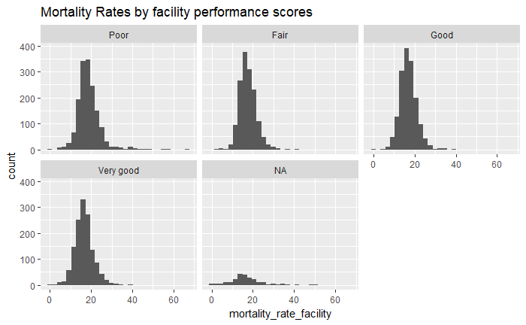
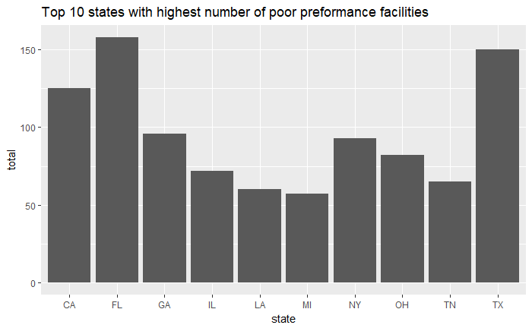
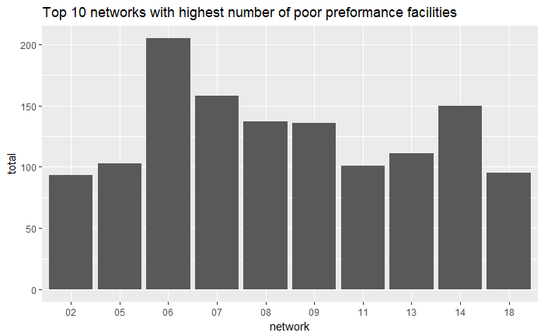
Poor performance in states and networks
There are more facilities with higher mortality rates in poor performing networks
FL, TX, CA, GA, NY, OH, IL, TN, LA, MI are states with highest number of ‘poor’ preforming facilities

Slide 15
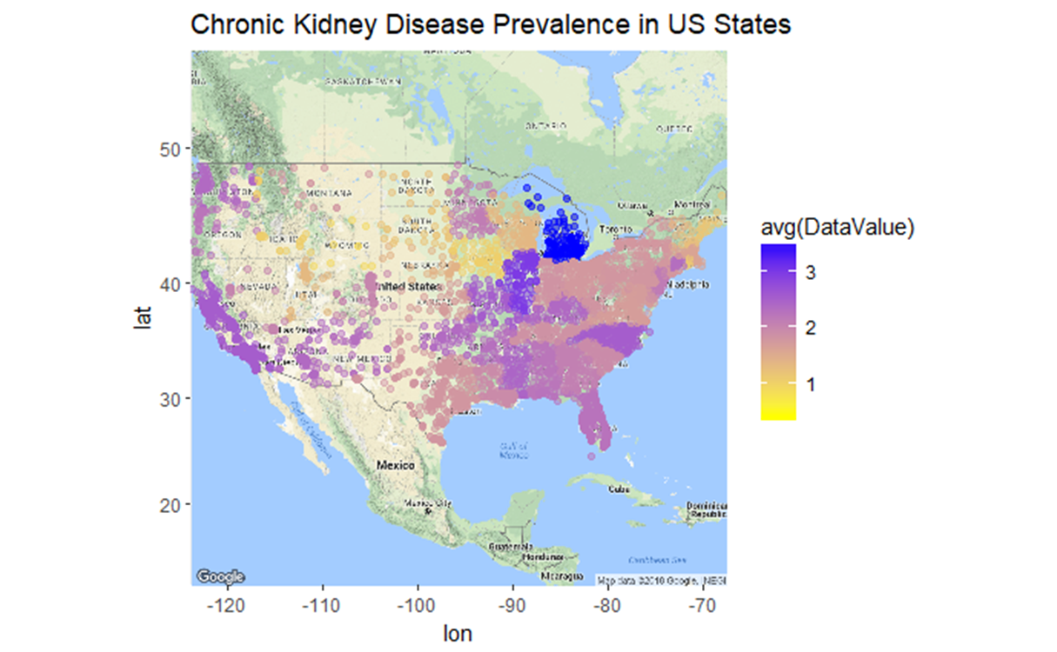
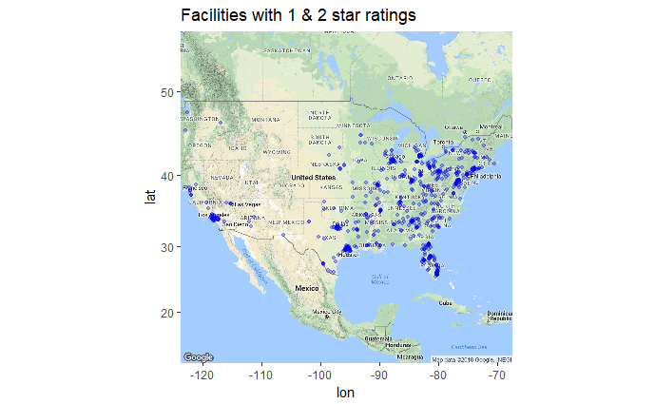
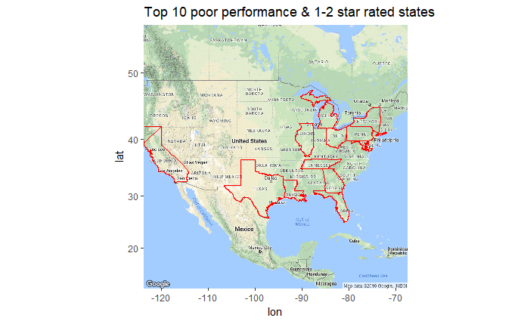
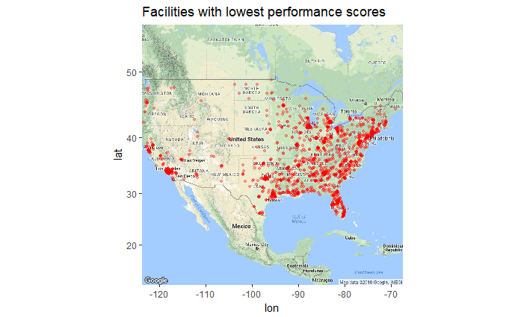
Poor performance in states and networks

Slide 16
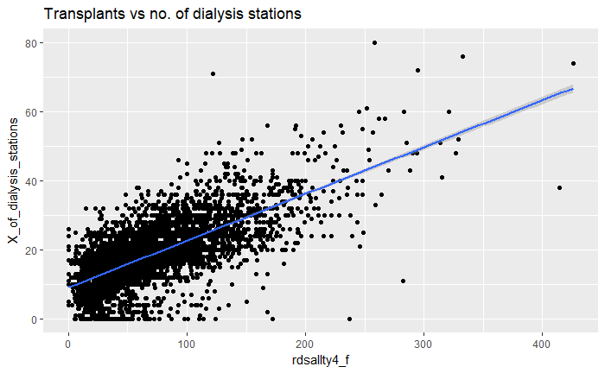
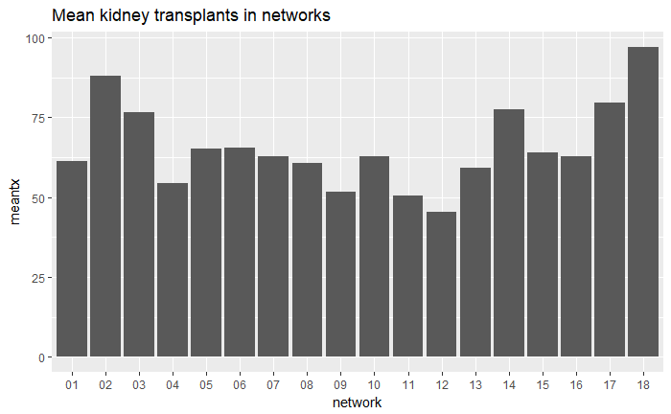
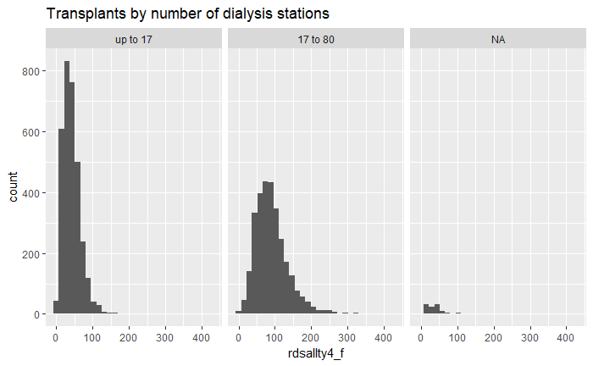
Kidney Transplantation
The mean number of kidney transplants in networks is 65 transplants
The number of transplants in networks is strongly correlated with the number of dialysis stations in networks

Slide 17
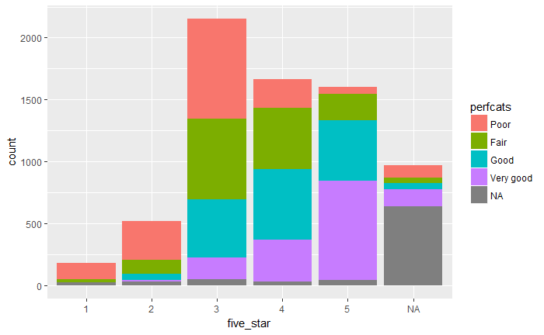
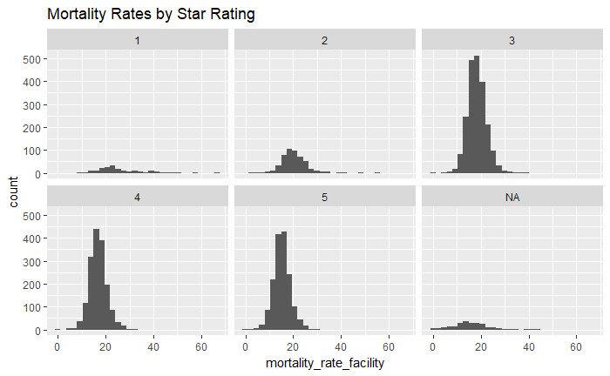
Five Star Rating
A majority of facilities are 3,4,5 star rated (n=5418), 698 facilities are 1 or 2 star rated
FL, TX, GA, CA, NY, OH, IL, TN, LA, MI have most facilities with poor or 1-2 star rated facilities
Histogram shows that even though fewer facilities have 1 & 2 star ratings, the mortality in these facilities is much higher (40)

Slide 18
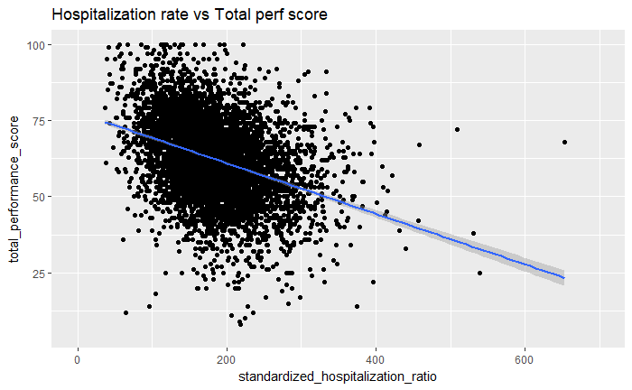
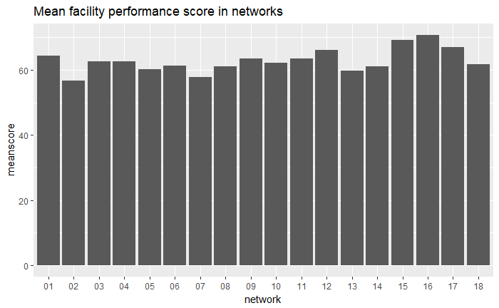
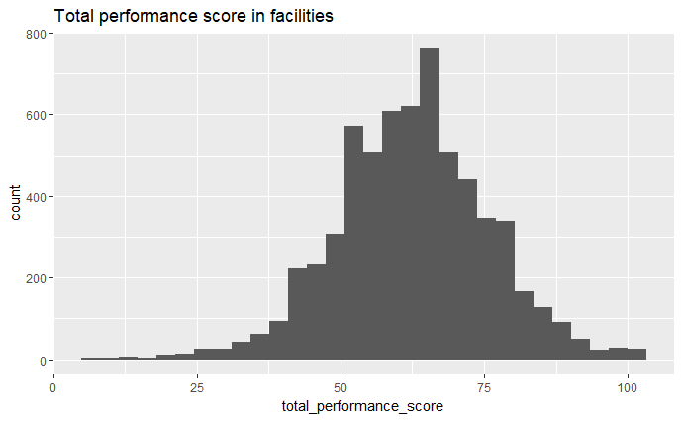
Facility Total Performance Score
Add faceted payment percentage graphs here
Mean total performance score in networks is 62

Slide 19
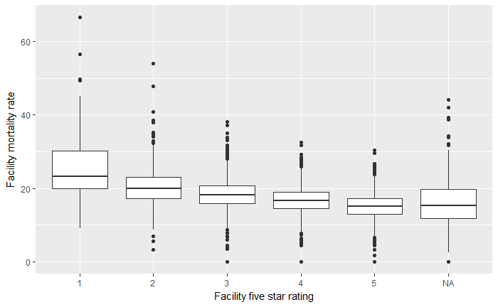
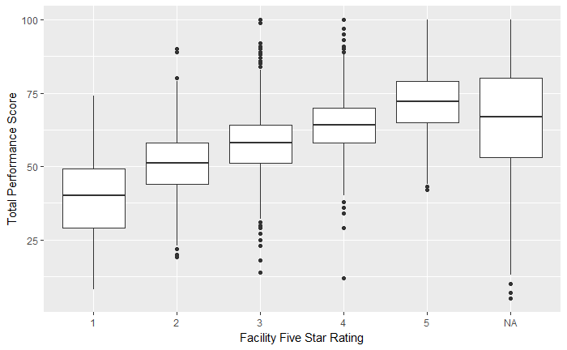
So what makes a state a “good” performer?
Mortality rate averages do not vary much between performance score categories
Total performance scores vary between facility star rating
What are the predictors of facility total performance score?

Slide 20
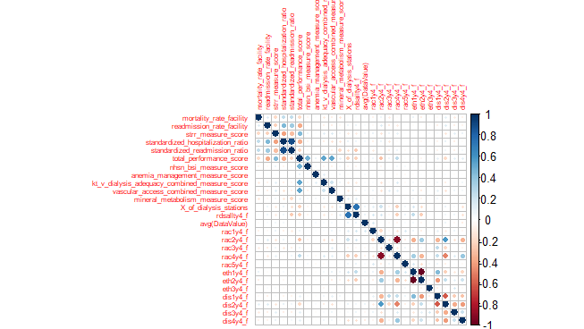

Slide 21
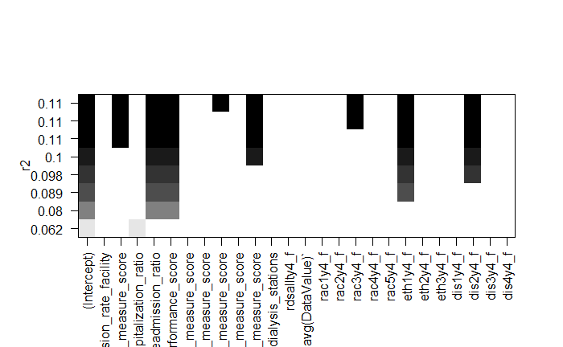
Regression: Modeling predictors of Facility Performance
Examining the corrplot output, Mortality rate is not highly correlated with other variables
Steps/ leaps function also does not show a strong predictive model for Mortality rate
The R-squared value for the best model using steps is 0.11
So this led to a change in focus of modeling- I decided to make a model for predictors of total performance score

Slide 22
Predictors of Total Performance Score
By examining the corrplot output, I created a model using the ‘lm’ function iteratively
The final model for total performance score contained 6 predictors, with R squared value=0.85
The model shows that facility total performance score can be predicted by facility readmission rate, standardized hospitalization ratio, transfusion score, blood stream infection measure score, dialysis adequacy score, and combined vascular access score

Slide 23
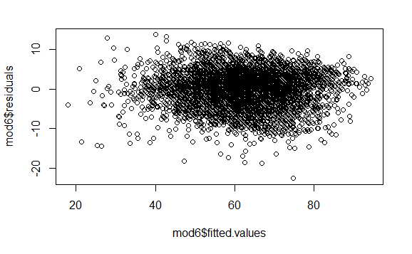
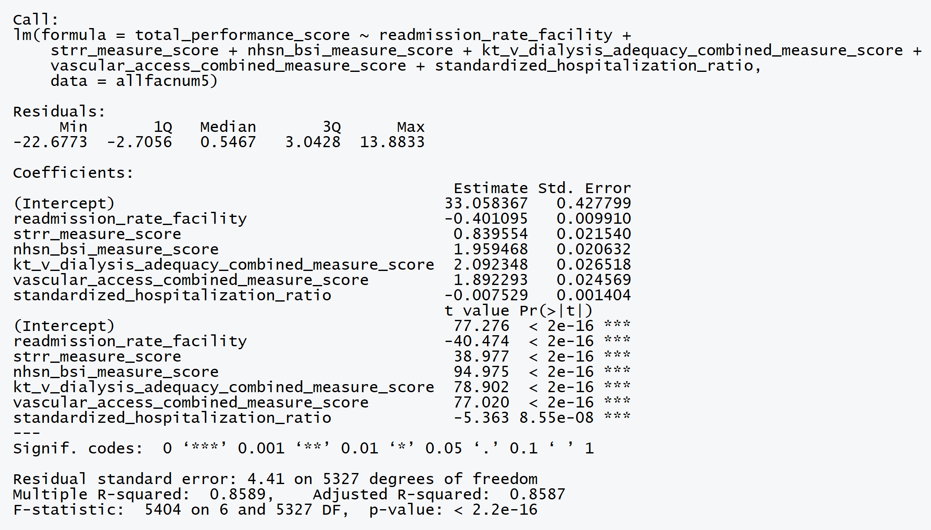
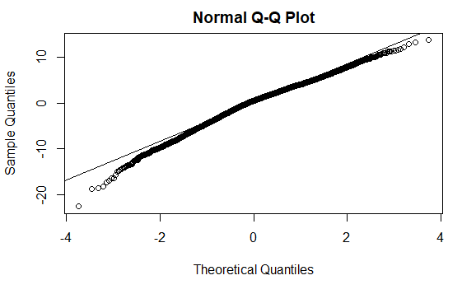
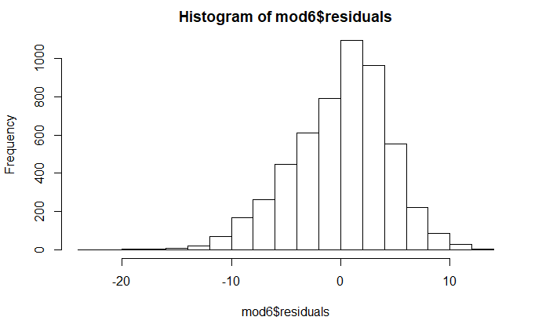
Regression model output

Slide 24

Cluster Analysis
Selecting the data for clustering:
For clustering analysis, I used complete cases for data filtered by mortality rates >= 5 and <=30 (between 5-30)
I applied assumptions of a range of 1-8 clusters, then used Nbclust and Mclust packages to predict number of clusters
I did not reach a definitive conclusion about the perfect number of clusters

Slide 25
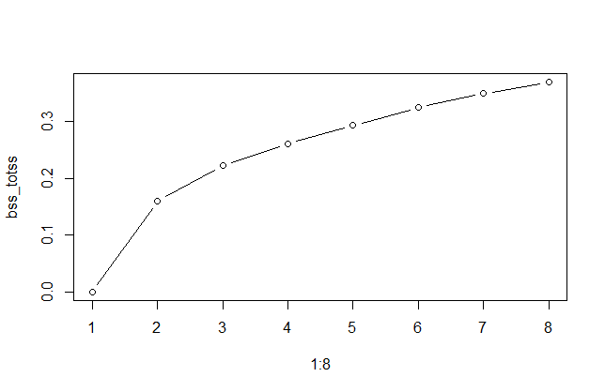
Kmeans Clustering: Code
# Create a list 'kvalue' to store results of each kmeans cluster algorithm model
kvalue <- list()
for(i in 1:8){
kvalue[[i]] <- kmeans(scaled.allfac,i)
}
# Calculating ratio between sum of squares and total sum of squares
bss_totss <- list()
for (i in 1:8){
bss_totss[[i]] <- kvalue[[i]]$betweenss/kvalue[[i]]$totss
}
# Check the "elbow" plot
plot(1:8,type="b",bss_totss)
Can you identify the elbow?

Slide 26
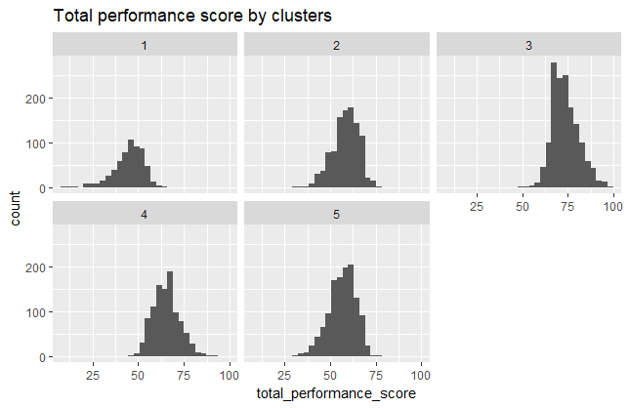
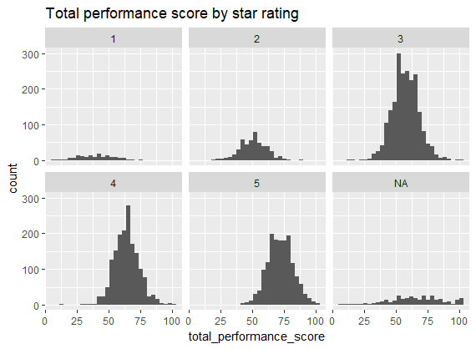
Kmeans clustering: Do the predicted clusters follow 5 star rating?
Add table comparison values here

Slide 27
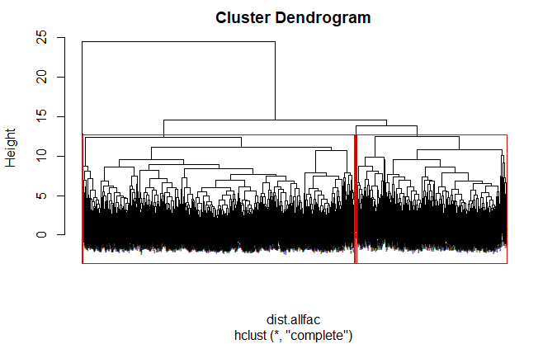
Heirarchical Clustering
dist.allfac <- dist(scaled.allfac)
allfac.clust <- hclust(dist.allfac,method="complete")
plot(allfac.clust,cex=0.1)
rect.hclust(allfac.clust, k=5, border="red")
Overall, hierarchical clustering does not do very well in identifying clusters for this data
The clustering algorithm tends to group a majority of cases in two clusters, and does not align well with the expected data patterns

Slide 28
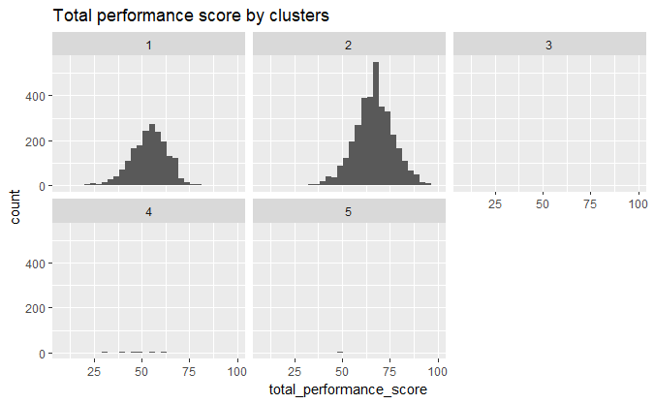
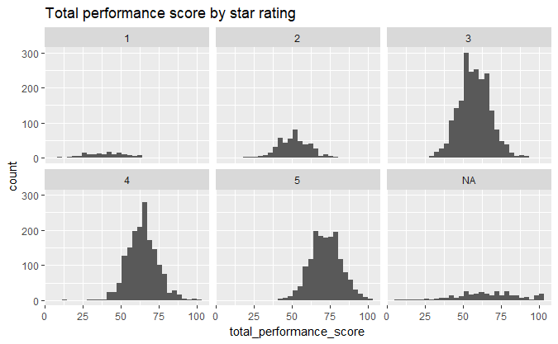
Heirarchical clustering: Comparing mortality histogram with observed distribution for five-star ratings
allfac_5 <- cutree(allfac.clust,5)
clust_labs <- factor(allfac_5)
allfac.num4$hlabs <- clust_labs
allfac.num4 %>% ggplot(aes(x=total_performance_score)) + geom_histogram() +
ggtitle("Total performance score by clusters") + facet_wrap(~hlabs)
The histogram on the left shows that most cases have been allocated to cluster 1 (n=1893) and 2 (n=3429), and the cluster algorithm does not produce a pattern consistent with the observed distribution in 5 star ratings

Slide 29
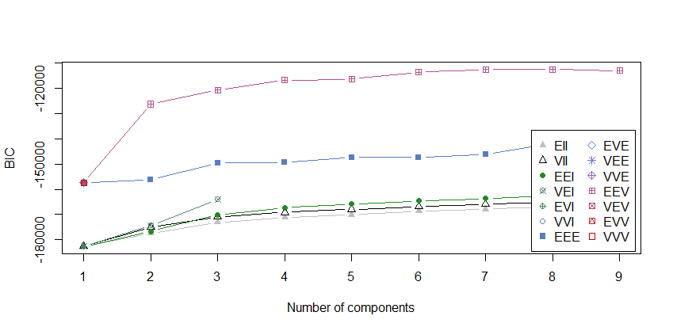
R packages used for Clustering: Mclust
Package ‘Mclust’ uses varied statistical modeling techniques to predict optimal number of clusters
Code:
library(mclust)
allfac.mclust <- Mclust(scaled.allfac)
allfac.mclust
Output: 'Mclust' model object: best model: ellipsoidal, equal volume and shape (EEV) with 7 components

Slide 30
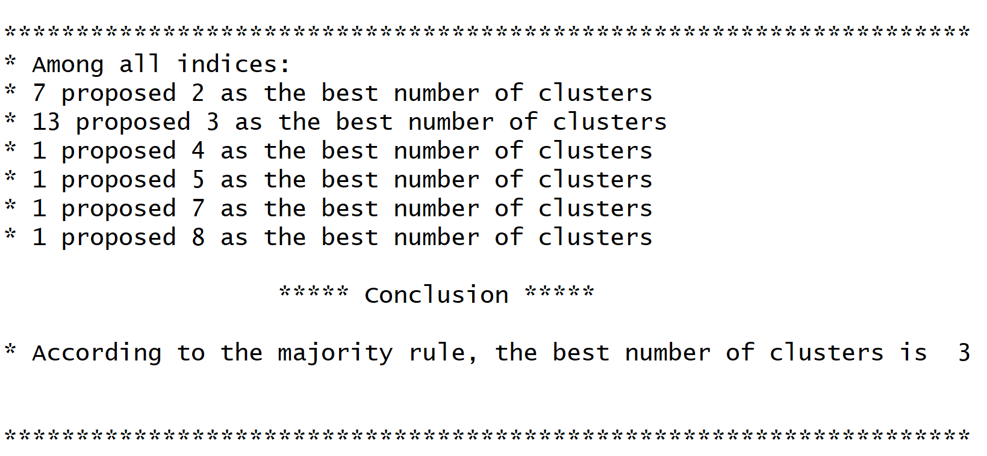
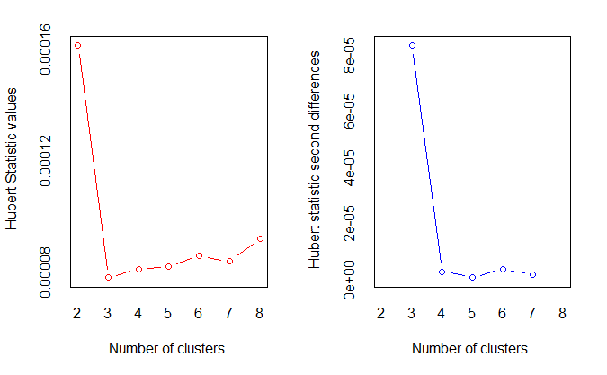
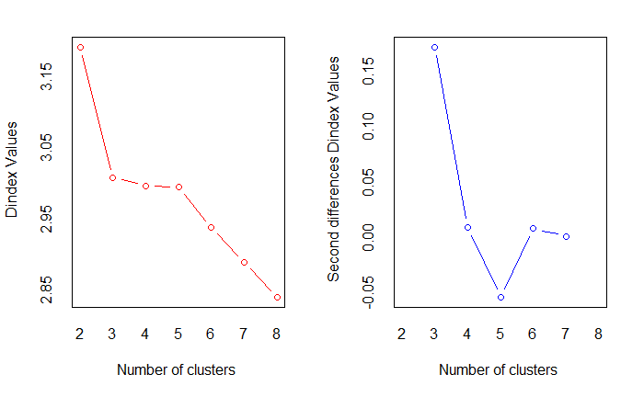
R packages used for Clustering: NbClust
res2 <- NbClust(scaled.allfac,distance="euclidean",min.nc=2,max.nc=8,method=“complete",index=“all")

Slide 31
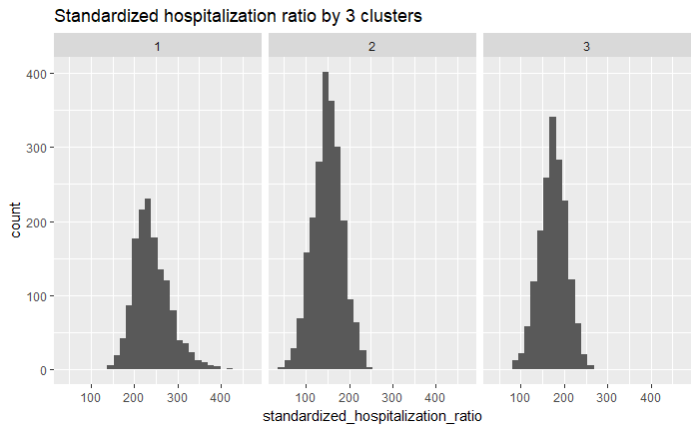
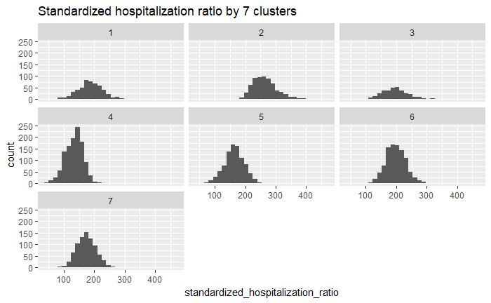
Kmeans with 3 clusters
Using the predicted value of three clusters, standardized hospitalization ratio ranges for cluster 2 and 3 seem similar
Using the predicted value of 7 clusters, clusters 2,3, 6 seem to have higher standardized hospitalization ratio values
The separation of clusters is not very clear

Slide 32
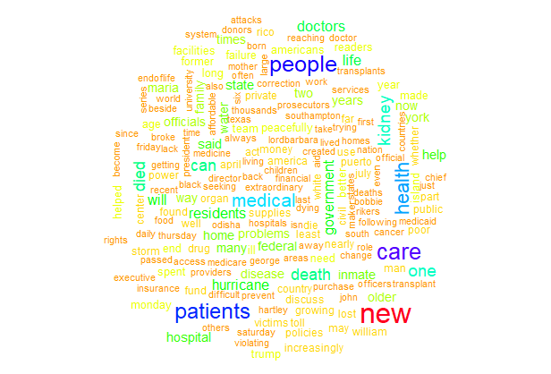
Sentiment analysis: Package rtimes
articles <- as_search("dialysis",begin_date = 20150101,end_date = 20180401, fl = c('web_url','headline','snippet'),all_results = TRUE)
Most articles do not have a direct reference to dialysis in the snippet, and are mostly interpreted as positive (negative=46, positive=147) . Snippets below were interpreted as ‘positive’:
[1] "Rosemary Billquist was walking her dogs near her home in a small town in western New York. The man who shot her was a neighbor she had watched grow up."
[2] "Terry Nelson, the inventor of the buoyancy suits used by many of the world’s top clubs and teams, found that training in water helped him move forward after his transplants."
[3] "Officially, 64 people died because of the storm, but an analysis by The New York Times suggests that the actual number is substantially higher."

Slide 33
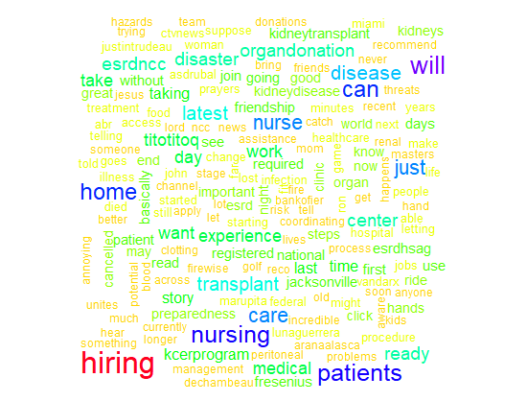
Sentiment Analysis: Package Rtweet
# searching for tweets in "poor" performing states
dia <- search_tweets("Dialysis",lang="en",n = 5000,retryonratelimit = TRUE,geocode = lookup_coords("fl","tx","ca","ga","ny"))
Most tweets are about job postings and hiring, and sentiment analysis shows mostly ‘positive’ sentiments (Negative= 15, positive= 124)
Below are a few tweets interpreted as ‘positive’:
[1] "Can you recommend anyone for this #job? Travel Dialysis Clinic Manager - Cutler Bay FL -#Nursing #Miami, FL #Hiring #CareerArc"
[2] "It's downloaded I'll make my character and we'll play tomorrow. I got dialysis in the morning. How does naming her the broadnax sound?"
[3] "RT @KCERprogram: Be Ready Be Firewise. Be aware of the potential fire threats and hazards in your community.#pre"

Slide 34
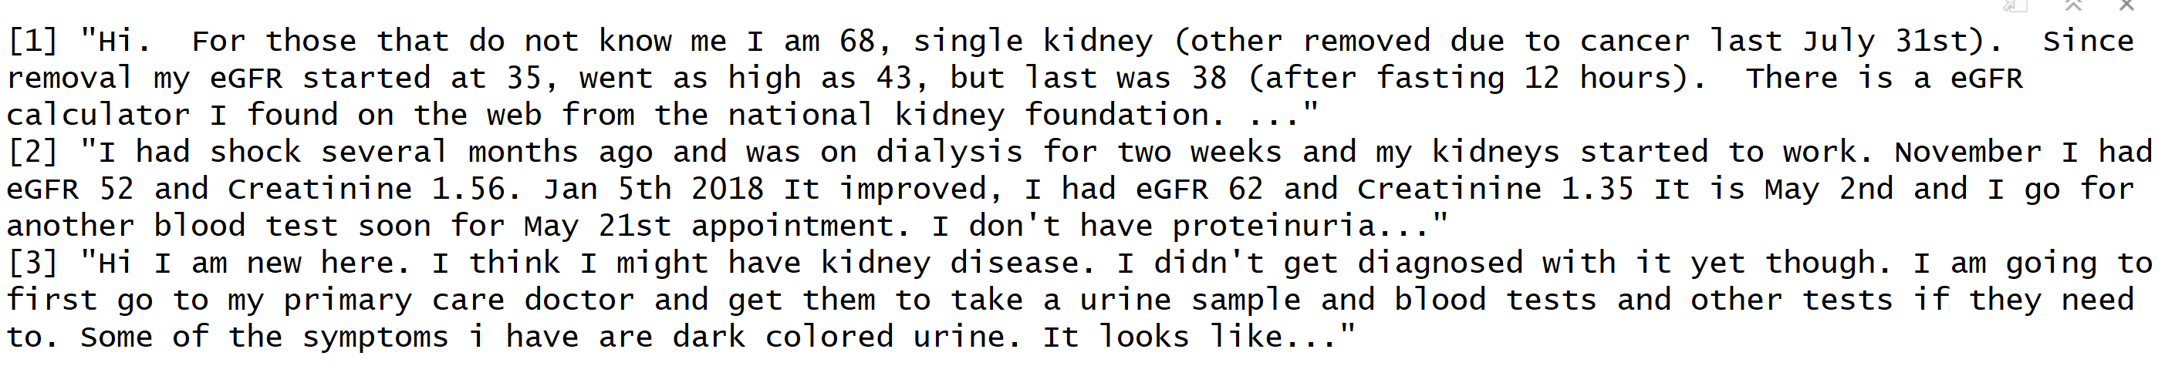
Sentiment Analysis: Web Scraping with package rvest
# Discussion forum on Kidney failure and Chronic Kidney Disease
url <- "https://patient.info/forums/discuss/browse/kidney-failure-and-ckd-1300#"
webtext <- read_html(url) %>%
html_nodes(xpath='//*[(@id = "group-discussions")]//p') %>% html_text()
Negative= 41
Positive= 14
Discussion samples:

Slide 35

Patient utility function
Created patient utility function ‘facinfo’ which takes zipcode input, and returns facility information and a leaflet map
Below is an example output for zip code 10461

Slide 36
Conclusions
Total performance score is most strongly predicted by facility readmission rate, standardized hospitalization ratio, transfusion score, blood stream infection measure score, dialysis adequacy score, and combined vascular access score. Facilities can focus on these measures to improve total performance scores
The current rating method seems to be a robust classification of facility characteristics, applied clustering methods do not identify any other specific clustering patterns within the data
The number of kidney transplants is strongly correlated with the number of dialysis stations in facilities. This would suggest that an adequate dose of dialysis is essential to sustain patient health for receiving transplants
There seems to be positive public discourse related to dialysis on social media and news, however not surprisingly, patient forums project negative sentiment.

Slide 37
References
Dialysis Facility Report data: https://www.dialysisdata.org/content/dialysis-facility-report-data
Dialysis Facility Compare Datasets: https://data.medicare.gov/data/dialysis-facility-compare (SOCRATA API)
https://www.niddk.nih.gov/health-information/kidney-disease/kidney-failure/hemodialysis
https://www.cdc.gov/dialysis/patient/index.html
US Chronic disease indicators:https://catalog.data.gov/dataset?tags=chronic-kidney-disease - JSON export available
http://esrdnetworks.org/membership/esrd-networks
https://www.cms.gov/Medicare/End-Stage-Renal-Disease/ESRDNetworkOrganizations/

Slide 38
Questions?

